Slide 1
Nearest State/County Finder
Rachid Tak Tak

Slide 2
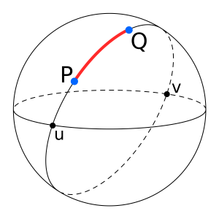
-Reference points dataset from US board
-User inputs latitude and longitude
Find the nearest K reference points (1 to 10 points)
Find State and County of the input by 5 point Voting

Slide 3
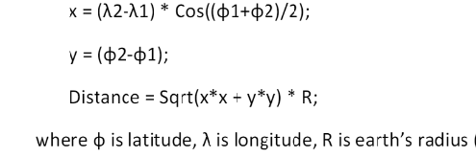
Equirectangular approximation of distance:
Goal: Speed of search
Design choices: data structures, alternative algorithms
Plan: Start with simple CLI that allows user to input point, calculate distance and compare with list of reference points O(n). Then, change data structure and algorithm to find fastest.

